Slide 1


Slide 2
The Application of Technology Maturity Metrics for Adoption of Artificial Intelligence Technologies
A Study of the Emergency Management Technology 9-1-1 Service using Speech Recognition
April 6 2020 / Michael F. Strobel

Slide 3
Proposal Defense Outline
The Proposal Defense Outline
Committee Members
Introduction – Problem Statement
Introduction – Problem Motivation
Problem Background
Uniqueness of Approach
Proposed Methods Discussion
Proposed Methods
Results
Conclusions & Future Research
Publication Plan & Strategy
Backup Slides

Slide 4
Committee Chair and Members
Dr. Catherine Dwyer - Advisor
Pace University Seidenberg School of CSIS
Dr. Zhan Zhang
    Pace University Seidenberg School of CSIS
Dr. Brian Sauser
    University of North Texas, G. Brint College of Business

Slide 5
Introduction-Problem Statement
Problem Statement
Speech Recognition technologies are available for everyday use. Emergency Services, E-911, ‘0’ (Operator) et al., is a key element in telecommunications and Public Services. Speech Recognition technologies are not employed in Emergency Services solutions.

Slide 6
Introduction-Problem Motivation
Problem Motivation
Speech recognition as a subset of A.I is absent from the Emergency Management, 9-1-1 service in the U.S. and other derivations e.g., 1-1-2 in Europe and other numbering systems globally.
Provide the ability to avoid network overload and save lives.
Achieve user and provider acceptability of speech recognition solutions for the 9-1-1 service.
Evidence of Need: Events have overwhelmed the capacity and capabilities of the systems most notable, hurricanes Harvey in Houston, Katrina in New Orleans and Sandy in New York and New Jersey.
My professional interests in the subject matter includes publication of research “There Will Be Significant Economic, Social and Policy Implications of Speech Processing Technology for Telecommunication Providers and Consumers.” (1999).

Slide 7
Problem Background
Problem Background
Speech recognition as a subset of A.I. applications is not ubiquitous in its acceptance in many areas by the public or industry and has not been adopted for use in applications where can benefit greatly.
The 9-1-1 emergency service in the U.S. and other derivations like 1-1-2 in Europe and other numbering systems globally.
Through review with leadership at the National Emergency Number Association (NENA) and interviews with telecommunications industry subject matter experts, there are no 9-1-1 speech recognition capabilities deployed or scheduled for standards development.

Slide 8
Problem Background
Deficiencies in Evidence
Through the literature review process, the absence of research in speech recognition (the A.I. application) and 9-1-1 and also emergency services supported the pilot paper generation.
Targeting the standards body NENA (National Emergency Number Association) for 9-1-1 and the SME interview process demonstrated:
1: Absence of effort to adopting the speech recognition in 9-1-1.
2: Emergent theme - the public may be open to the speech recognition as A.I. in the 9-1-1 service.
3: It could serve to influence the inclusion of the technology for consideration by the standards bodies which is not present today.

Slide 9
Problem Background
Deficiencies in Evidence
Through the absence of data in this area, I and Dr. Cathy Dwyer prepared a Pilot Paper “Obstacles to Adopting Speech Recognition in Emergency Services Solutions”.
The paper was accepted by the Association for Information Systems (AIS) for the Emergent Research Forum in the Technology Adoption Track and presented at the AMCIS 2018 Conference.
33 AIS Library Downloads globally to date.
AMCIS 2018 ERF poster – Backup Slide

Slide 10
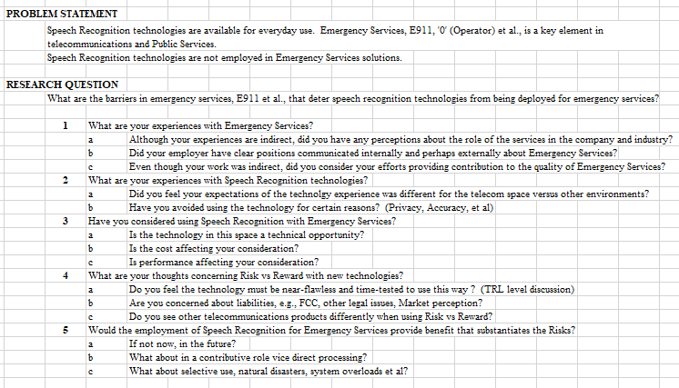
Problem Background
Deficiencies in Evidence
The investigation process followed the Grounded Theory Approach (Strauss) where the approach is one of developing theory that is “grounded in data systematically gathered and analyzed. The interview method employed was a semi-structured design.

Slide 11
Problem Background
Deficiencies in Evidence
The volunteer interview subjects are for the study on average exceeded 25 years of professional and telecommunications experience and all had some degree of experience with the 9-1-1 Emergency Service.
The interviews result is over 150 pages of transcript conversations for further qualitative analysis e.g., NVIVO et al.

Slide 12
Problem Background
Deficiencies in Evidence
The themes of Liability, Legal and Reputation; Standards 9-1-1 and Technical Risk and Mitigation emerged from the interview questions as relevant.
Through the interviews three themes were noted in the obstacles to speech recognition in emergency services.
While there were differing opinions at times, Subject C stated clearly:
“My take is that when we first started talking, and I still believe this, is that people call 9-1-1- and they don’t care who completes the call, Verizon et al., they don’t care. Get me to a call taker so I can get help!

Slide 13
Uniqueness of Approach
Uniqueness of Approach
The use of the Technology Readiness Levels (TRLs) applied as a tool to measure S.R. (A.I.) readiness and influence users intentions and future behavior.
The research model for this study is an extension of the Unified Theory of Acceptance and Use of Technology Model (UTAUT) (2003).
The UTAUT model is a formulated model developed from research that conducted a review and synthesis of eight models in use for technology acceptance.

Slide 14
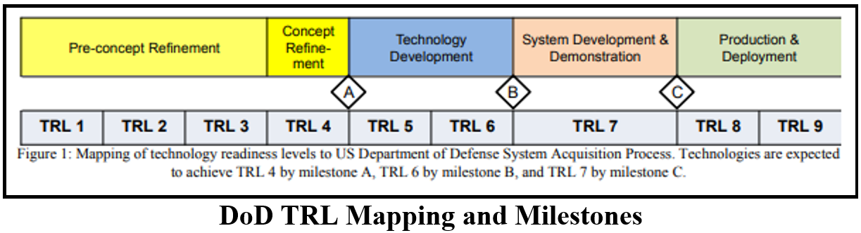

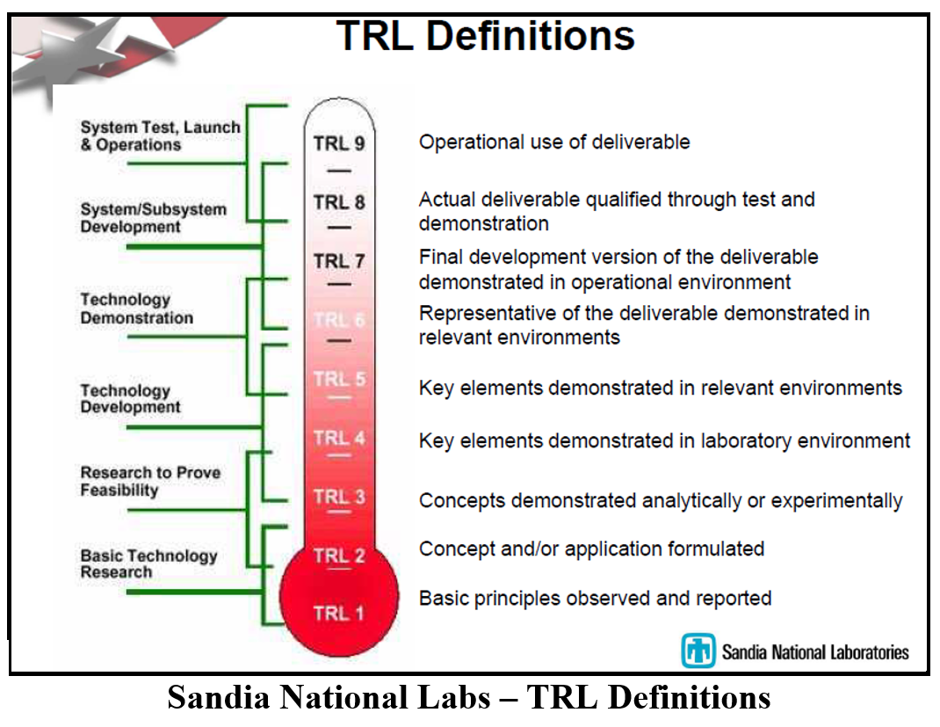
Uniqueness of Approach
Uniqueness of Approach
Using tools designed for engineers to communicate and invoke confidence.
Where the U.L. tag demonstrates to citizens the safety of a product for use, so too does the TRL “7 and above” rating or simply “TRL Approved” when applied to a technology that it is safe for use.
In the application of S.R.-A.I. to the 9-1-1 Emergency Services system, the prediction is that a TRL educated citizen will demonstrate higher level of support for the technology in 9-1-1 and a willingness to use the technology.

Slide 15
Methods
Statement of Research
“Does the use of the Technology Readiness Level (TRL) metric and training of subjects (citizens) make a positive difference in the support for adoption of the Speech Recognition – Artificial Intelligence technology for the 9-1-1 Emergency Service” ?
The following hypothesis serve as declarative predictions about the anticipated relationships among the variables.
H1: The Treatment, TRL, will increase the intent to use for speech recognition for 9-1-1 emergency services.
H2: Age will have an effect on the intent to use for speech recognition for 9-1-1 emergency services. Younger subjects will demonstrate an increased willingness to adopt the technology.
H3: People’s Expectations will be improved by the treatment, increasing the intent to use for 9-1-1 emergency services.
H4: Peoples Perspectives will be improved by the treatment increasing the intent to use for 9-1-1 emergency services.
H5: Education will have an effect on intent to use for 9-1-1emergency services. Higher formally educated subjects will demonstrate an increased willingness to adopt the technology.
H6: Gender will have an effect on intent to use for speech recognition for 9-1-1 emergency services.
Problem Research Secondary Questions – Backup Slide

Slide 16
Methods
Complimenting Existing Research
The proposed research will serve to compliment the existing research body of knowledge through:
  The unique aspects of the research in the adoption and diffusion of technology
  Extension of the use of TRLs.
The proposed study by focusing on the speech recognition as an A.I. application can be viewed from the perspective of “Speech Recognition as a Subset of Artificial Intelligence” and as a “Subset of Emergency Management”
  Through the findings of the study, the further goal is to generalize to the larger population of A.I. applications.
The proposed study by focusing on the speech recognition as an A.I. application for the 9-1-1 emergency service can be viewed through the perspective as a “Subset of Emergency Management”
  through the findings of the study, there is opportunity to further generalize the results to the broader Emergency Management applications and services.

Slide 17
Methods
The Body of Work:
Proposed Methods - Discussion
The methods of research for the proposal consist of the following:
Quantitative Data
  Development of the Research Methodology Design
    Randomized Posttest-Only Control-Group Design
  Extension of the Venkatesh UTAUT Model
  Survey Tool – Control and Experimental Groups
Qualitative Data
  Grounded Theory, Semi-structured interviews
  Interview data
  Coding Analysis – Themes/Concepts
  NVIVO Tool

Slide 18
Methods-Qualitative
Qualitative Data: Grounded Theory, Semi-structured interviews.
  The paper was presented at the AIS – AMCIS Conference 2018. The Technology Track the ERF paper was adopted under was the “Adoption and Diffusion of Information Technology”
  The qualitative paper’s goal was to explore the obstacles to adopting speech recognition into Emergency Services with 9-1-1 as the preeminent service in North America and replicated in other versions and dialing patterns internationally. The study focused on primary research through the interview method.
  Interview data: The data collected from interviews for the AIS-AMCIS 2018 ERF paper is about 150 pages of transcripts from recorded interviews that served to refine the research.
  NVIVO: This tool was reviewed but not fully employed for the development of the ERF paper.
    The use of the NVIVO tool and the admission of the transcript data would be the next step in coding and analysis of the interview data collected.

Slide 19
Methods-Qualitative
Qualitative Data: Grounded Theory, Semi-structured interviews.
Coding Analysis – Themes/Concepts. Open coding methods were employed. The emergent research themes from this paper are:
    Consumers are changing and may readily accept implementation in select scenarios deemed desirable.
    Satisfaction may result from consumer and public safety from the states and their PSAP operational requirements to obtain momentum for national support.
    Use Cases for law enforcement should be considered as an opportunity for public support.
    Universal acknowledgment that caller to E-911 may experience stress affecting search quality.
    Sound detection and association with other media and call artifacts suggested as practicable, but not compatible with the Standards processes.
    Unanimous support from interview subjects for continued research.
    Obstacles
      Liability, Legal and Reputation (Subject A “Huge! This is one of the reasons General Dynamics has taken stepps back on investments of almost sure gains…”)
      Standards 911 (There is a gap in the standards for Emergency Services versus other technology environments)
      Technical Risk and Mitigation (Houston Hurricane (call volume 8 times normal) (Full automation of 911 was not an acceptable use case for a majority of the subjects interviewed 6 of 7)

Slide 20
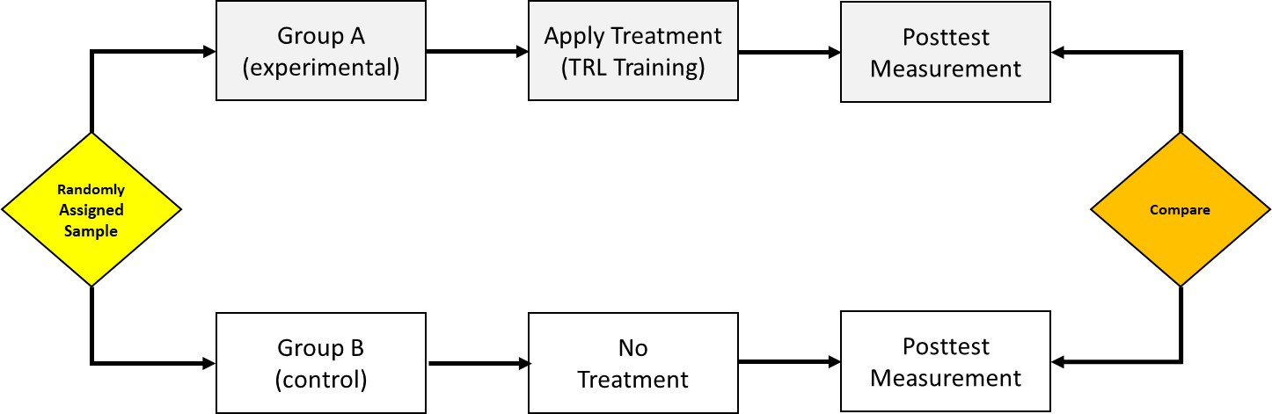
Methods - Quantitative
Quantitative Data: Development of the Research Methodology Design
The research design proposed for this study is the “Single-Variable, Independent-Groups Design” and will utilize the “Randomized, Posttest-Only, Control-Group Design”(Raulin).
The experimental design selected will unlike non-experimental designs such as Ex post facto studies et al., exploit two critical factors, control groups and randomization that will assist in controlling most of the sources of confounding.
Through the use of experiment the confidence level in drawing causal inferences is increased.
This experimental design will serve to determine if manipulation of the treatment, Technology Readiness Level (TRL) metrics influences the users willingness to adopt the speech recognition technology for 9-1-1- emergency services. The single variable will be training on the TRL measurement system (metric) Training.

Slide 21
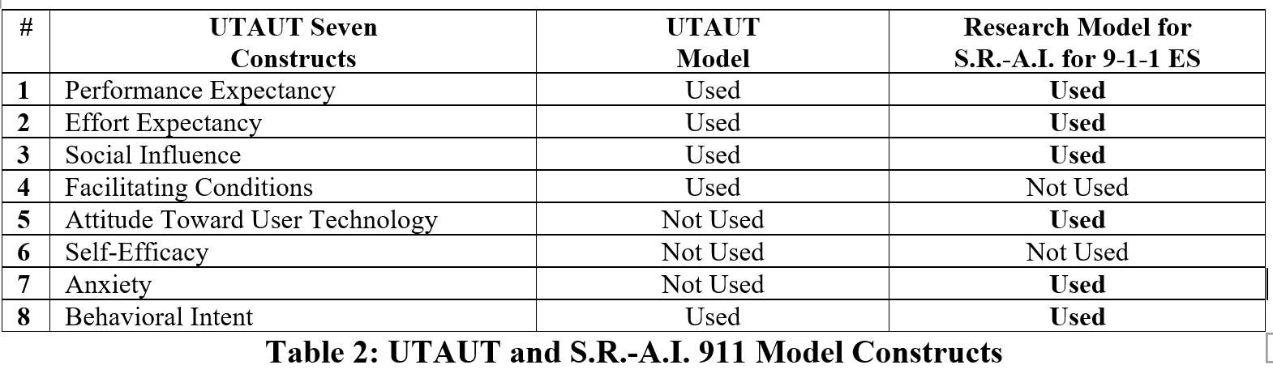
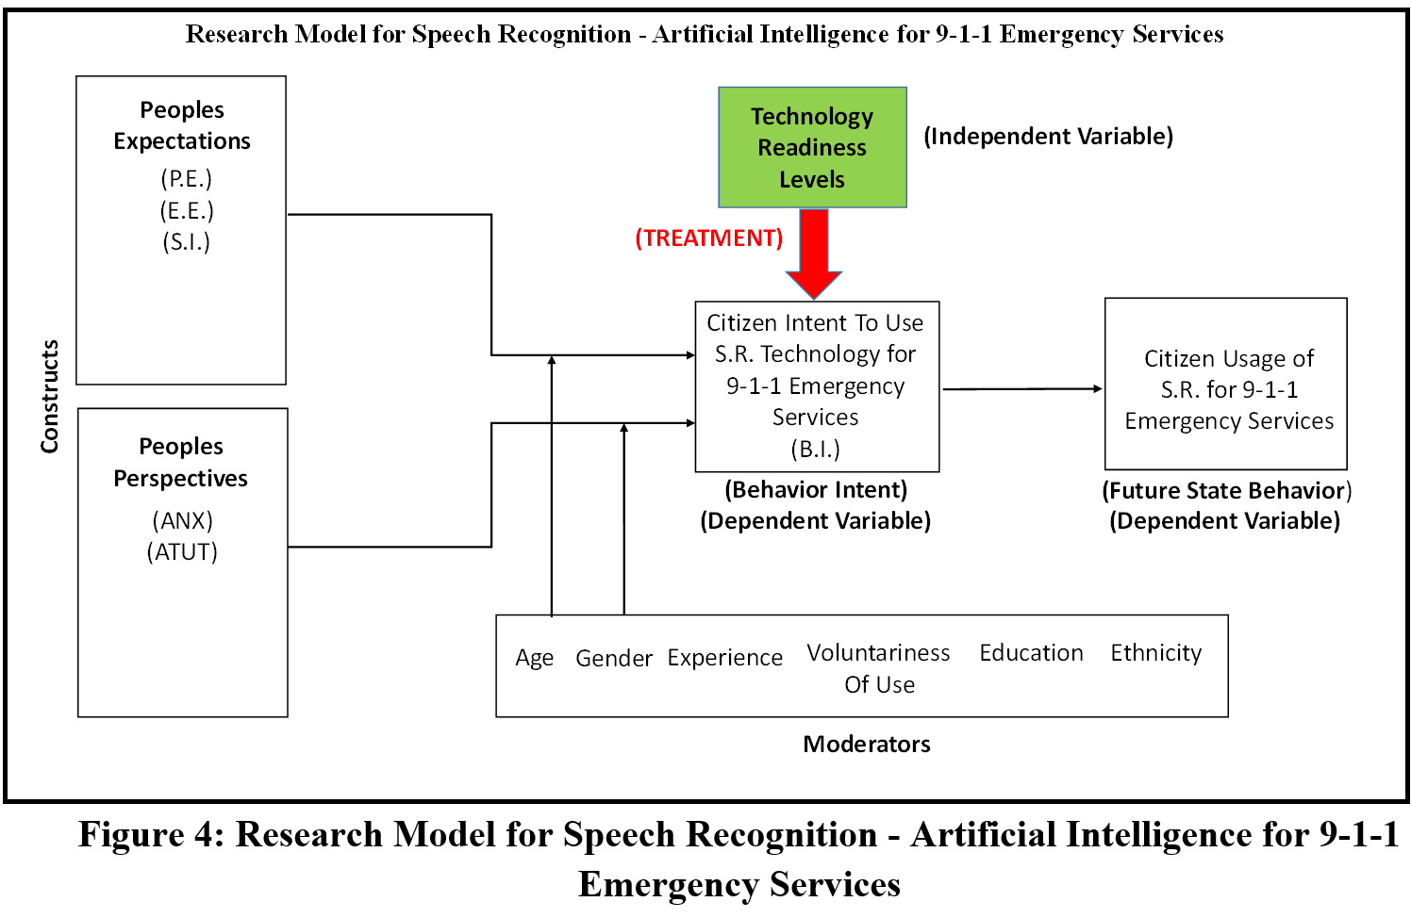
Methods - Quantitative
Quantitative Data: Extension of the Venkatesh UTAUT Model
The UTAUT is an IT acceptance research model employed as source for this study, it serves as a baseline for the research model for this study. The research model construct mapping demonstrates the conceptual crafting of the groups.
The model provides groups of constructs “Peoples Expectations” and “Peoples Perspectives” The aggregation provides for the first level analysis of data with the lower layers at the construct level.
The collection and measurement of data will test the hypothesis of the effect of the TRL training as the Independent Variable on the Citizen Intent to Use the S.R. Technology for 911 Emergency Service.
Operational Definitions are the I.V. (TRL Training), D.V. (Behavioral Intent) and D.V. (Future State Behavior).

Slide 22
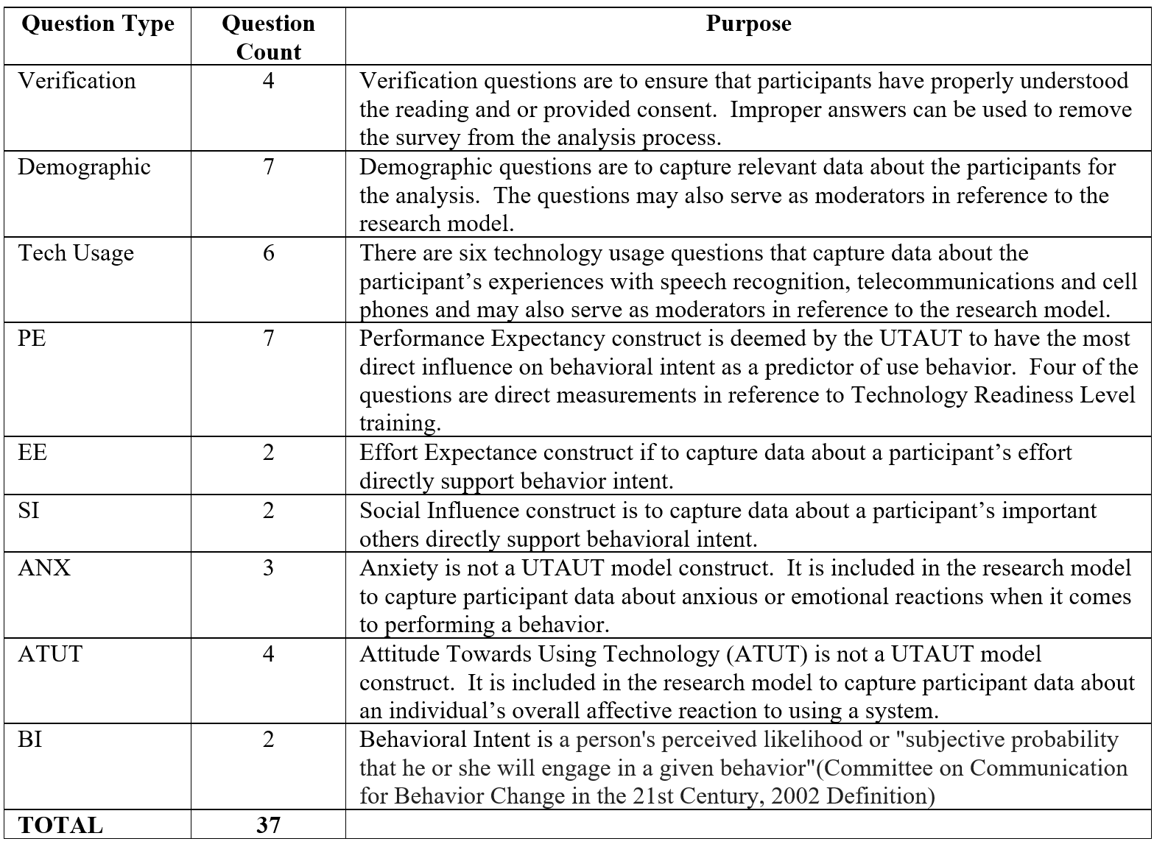
Methods
Quantitative Data: Survey Tool – Control and Experimental Groups
The survey will serve as the tool to administer the testing of the experimental and control groups. The survey tool is two individual surveys that are randomly assigned to willing participants.
The ‘A’ survey is the experimental “treatment” survey and the ‘B’ survey is the control group. The treatment in the experimental survey is the training provided to the participants of survey ‘A’ for Technology Readiness Levels (TRLs).
The survey is implemented through (Pace) Qualtrics and has been tested and revised to include revisions to the sequence of the questions. The average time is about 12 minutes to complete in the final form.
The question types, count and purpose for each group is provided. The question formulation for the UTAUT constructs are based on the formulation of the Venkatesh questions as a verified source for the question structure.

Slide 23
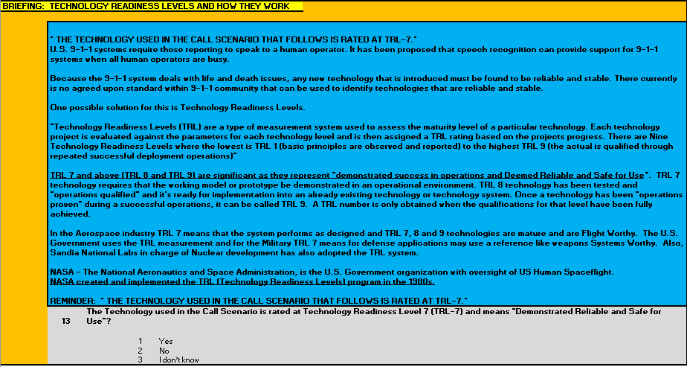
Methods
Quantitative Data: Survey Tool – THE TREATMENT & VERIFICATION

Slide 24
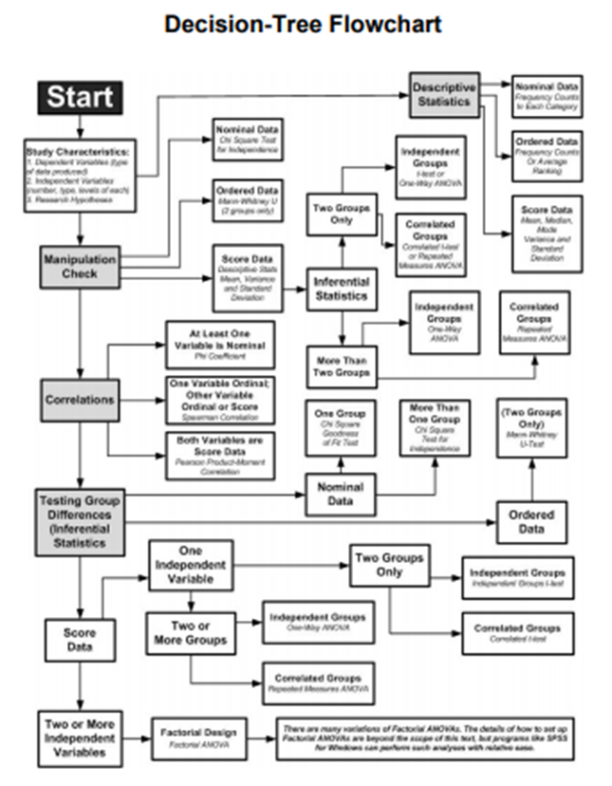
Methods
Testing Decision Tree Flowchart – Raulin
The primary methodology for testing the hypothesis will be the use of the Likert Scale survey data, treated as ordinal. The data will also be applied as score data to support mean median and mode and support inferential and correlations analysis.
All Likert Scale questions following the treatment and 9-1-1 call scenario are 4 level questions.
Analysis with SPSS will support Descriptive, Manipulation and Testing Group Differences.
Correlations between peoples expectations and perspective group constructs with behavioral intent will be analyzed.
The effects of moderators on peoples expectations and perspective group constructs will be analyzed.
The resultant impact on behavioral intent will be the primary measurement for hypothesis 1.
H1: The Treatment, TRL, will increase the intent to use for speech recognition for 9-1-1 emergency services.

Slide 25
Results
Survey Data: Quantitative (sample: control 22 / treatment 28) (Backup Slide)
The analysis for the purpose of preliminary testing is a subset of the “People’s Expectations” group and reflects those constructs through the UTAUT model have been demonstrated to have the most influence on support and usage of a technology. There are seven PE and two BI questions in the survey tool.
From the descriptive presentation of the Frequency Report, I have coded in Green the Mean (average) score of responses to the PE and BI questions.
There is a distinct pattern where the mean score to the PE and BI questions are higher in the treatment group and have in general (not exclusively) a smaller (tighter) standard deviation.

Slide 26
Results
Survey Data: Quantitative (sample: control 91 / treatment 83) (Backup Slide)
The analysis for the purpose of preliminary testing is a subset of the “People’s Expectations” group and reflects those constructs through the UTAUT model have been demonstrated to have the most influence on support and usage of a technology. There are seven PE and two BI questions in the survey tool.
From the descriptive presentation of the Frequency Report, I have coded in Green the Mean (average) score of responses to the PE and BI questions.
There is a distinct pattern in the smaller sample has become mixed. The demographics of the control group may correlate to greater acceptance.

Slide 27
Results
Survey Data: Quantitative (small and large sample)
FREQUENCY: B.I. 1.
The table below represents the SPSS Frequency Distribution histogram and normalized curve for construct the question measuring Behavioral Intent (B.I.).
“I INTEND TO USE THE SPEECH RECOGNITION SYSTEM FOR THE 9-1-1 SYSTEM.”

Slide 28
Results
Survey Data: Quantitative (small and large sample)
FREQUENCY: B.I. 2.
The table below represents the SPSS Frequency Distribution histogram and normalized curve for construct the question measuring Behavioral Intent (B.I.).
“I PLAN TO USE THE SPEECH RECOGNITION SYSTEM FOR THE 9-1-1 SERVICE.”

Slide 29
Results
Survey Data: Quantitative (large sample)
Observation: The demographic, moderators, may influence the control vs treatment.
Conclusion: Greater randomness between groups is required.
FREQUENCY: Demographics (moderators)
Note: slightly higher expectation for 9-1-1 to work every time in the treatment group.
For the large sample set, the demographics of the control group ‘A’ shows the following and may have an influence on the receptiveness of speech recognition and A.I. for the 9-1-1 service.
Gender: no meaningful difference, 53 % male both groups.
Age: (21-29) meaning difference, control 59.3% vs treatment 48.2%
Education: meaningful difference, (B and G) control 92.2% vs treatment 84.3%
Ethnic: meaningful difference, control (36.3% W – 54.9% A) vs treatment (4.4% W – 34.9% A)
Language Comfort: meaningful difference, control 72.5% E vs treatment 83.1% E (enlish).
Geographic Origin: meaningful difference, control (41.1% US) & (40.0% India) vs treatment (59.8% US) & (17.1% India).

Slide 30
Conclusions/Future Research
The research to date demonstrates that there is a level of acceptance for speech recognition to be integrated with the 9-1-1 service.
Additional empirical research data and methods of collection are needed to achieve an increased level of randomness to mitigate confounding variables.
A request for funding from the Seidenberg School has been submitted to support survey development. A goal of 300 surveys for both control and treatment is desired, 600 total.
The research subject as demonstrated by industry interviews, conference feedback and preliminary empirical results is timely and warranted serving both Emergency Management and Artificial Intelligence areas of interest.

Slide 31
Publication Plan/Strategy
Propose paper titles | Potential Venue for the paper | Target date for first draft
Paper 1: The use of TRLs in the adoption of A.I. based technology. | AMCIS Conference 2021 (8-12) CN. (Adoption and Diffusion Track) | Date: 3-1-21
Paper 2: Enhancement to the E-911 standards using TRL for A.I. | NENA Conference 2021 (6-26) OH. | Date: 12-1-20
Paper 3: Application of TRL to emergency management information systems. | ISCRAM Conference 2021 (May) E.U. | Date: 11-1-20
Paper 4: Improving the support for the adoption of A.I. through the use of TRLs. | Journal of the Association for Information Systems (JAIS) | Date: 1-1-21

Slide 32
Contact
Michael F. Strobel
mstrobel@pace.edu

Slide 33
BACKUP SLIDES
Publication Plan/Strategy
AMCIS 2018 ERF Poster Session
Problem Research Secondary Questions
Survey Data – small sample
Survey Data – large sample

Slide 34
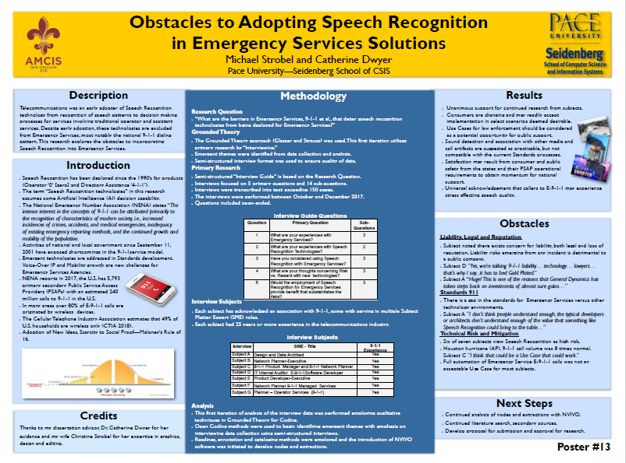
Problem Background
Deficiencies in Evidence
The research was presented at the AMCIS 2018 Poster Sessions.

Slide 35
Methods
Problem Research Secondary Questions
1: What are the subjects’ reasons for supporting adoption the use of Speech Recognition in 9-1-1 emergency service?
2: What are the subjects’ reasons for not supporting adoption the use of Speech Recognition in 9-1-1 emergency service?
3: What actions could be taken for subject’s to support adoption of Speech Recognition in 9-1-1 emergency service?
4: How generalizeable will the results of the study be for Artificial Intelligence (A.I.) beyond the studies application of speech recognition in emergency services?
5: How generalizeable will the results of the study be for Emergency Services beyond the studies application of speech recognition in 9-1-1?
6: What will be the effects of the constructs on the user’s behavioral intent?
7: What will be the effects of the moderators on the constructs?

Slide 36
Results
Survey Data: Quantitative: sample: control 22, treatment 28

Slide 37
Results
Survey Data: Quantitative: sample: control 91, treatment 83

Slide 38
Results
Survey Data: Quantitative (small sample)
FREQUENCY: P.E. 1.
The table below represents the SPSS Frequency Distribution histogram and normalized curve for construct the question measuring Performance Expectancy (P.E.).
“WHEN YOU MAKE A TELEPHONE CALL TO EMERGENCY SERVICES 9-1-1- DO YOU EXPECT THE CALL TO WORK THE SAME EVERY TIME?

Slide 39
Results
Survey Data: Quantitative (small sample)
FREQUENCY: P.E. 4.
The table below represents the SPSS Frequency Distribution histogram and normalized curve for construct the question measuring Performance Expectancy (P.E.).
“I WANT THE SPEECH RECOGNITION TECHNOLOGY IMPLEMENTED FOR THE 9-1-1 SERVICE.”

Slide 40
Results
Survey Data: Quantitative (small sample)
FREQUENCY: P.E. 6.
The table below represents the SPSS Frequency Distribution histogram and normalized curve for construct the question measuring Performance Expectancy (P.E.).
“I WOULD FIND THE SPEECH RECOGNITION SYSTEM USEFUL IN 9-1-1 SERVICE.”

Slide 41
Results
Survey Data: Quantitative (small sample)
FREQUENCY: P.E. 2. (TRL Q1)
The table below represents the SPSS Frequency Distribution histogram and normalized curve for construct the question measuring Performance Expectancy (P.E.).
“I AM CONFIDENT THAT THE SPEECH RECOGNITION TECHNOLOGY IN THE 9-1-1- SERVICE TO BE MATURE ENOUGH TO BE OF BENEFIT.”

Slide 42
Results
Survey Data: Quantitative (small sample)
FREQUENCY: P.E. 3. (TRL Q2)
The table below represents the SPSS Frequency Distribution histogram and normalized curve for construct the question measuring Performance Expectancy (P.E.).
“I AM CONFIDENT THAT THE ORGANIZATIONS RESPONSIBLE FOR THE 9-1-1 SERVICE WOULD ENSURE THE SPEECH RECOGNITION TECHNOLOGY IS MATURE ENOUGH TO BE OF BENEFIT.”

Slide 43
Results
Survey Data: Quantitative (small sample)
FREQUENCY: P.E. 5. (TRL 3)
The table below represents the SPSS Frequency Distribution histogram and normalized curve for construct the question measuring Performance Expectancy (P.E.).
“I AM CONFIDENT THAT THE SPEECH RECOGNITION TECHNOLOGY FOR THE 9-1-1 TELEPHONE CALL IS SAFE ENOUGH TO BE OF BENEFIT.”

Slide 44
Results
Survey Data: Quantitative (small sample)
FREQUENCY: P.E. 7. (TRL Q4)
The table below represents the SPSS Frequency Distribution histogram and normalized curve for construct the question measuring Performance Expectancy (P.E.).
“I AM CONFIDENT THAT THE 9-1-1 SERVICE WITH SPEECH RECOGNITION WILL PERFORM PROPERLY AND BE OF BENEFIT.”

Slide 45
Results
Survey Data: Quantitative (large sample)
FREQUENCY: P.E. 1.
The table below represents the SPSS Frequency Distribution histogram and normalized curve for construct the question measuring Performance Expectancy (P.E.).
“WHEN YOU MAKE A TELEPHONE CALL TO EMERGENCY SERVICES 9-1-1- DO YOU EXPECT THE CALL TO WORK THE SAME EVERY TIME?

Slide 46
Results
Survey Data: Quantitative (large sample)
FREQUENCY: P.E. 2. (TRL Q1)
The table below represents the SPSS Frequency Distribution histogram and normalized curve for construct the question measuring Performance Expectancy (P.E.).
“I AM CONFIDENT THAT THE SPEECH RECOGNITION TECHNOLOGY IN THE 9-1-1- SERVICE TO BE MATURE ENOUGH TO BE OF BENEFIT.”

Slide 47
Results
Survey Data: Quantitative (large sample)
FREQUENCY: P.E. 3. (TRL Q2)
The table below represents the SPSS Frequency Distribution histogram and normalized curve for construct the question measuring Performance Expectancy (P.E.).
“I AM CONFIDENT THAT THE ORGANIZATIONS RESPONSIBLE FOR THE 9-1-1 SERVICE WOULD ENSURE THE SPEECH RECOGNITION TECHNOLOGY IS MATURE ENOUGH TO BE OF BENEFIT.”

Slide 48
Results
Survey Data: Quantitative (small sample)
FREQUENCY: P.E. 4.
The table below represents the SPSS Frequency Distribution histogram and normalized curve for construct the question measuring Performance Expectancy (P.E.).
“I WANT THE SPEECH RECOGNITION TECHNOLOGY IMPLEMENTED FOR THE 9-1-1 SERVICE.”

Slide 49
Results
Survey Data: Quantitative (large sample)
FREQUENCY: B.I. 1.
The table below represents the SPSS Frequency Distribution histogram and normalized curve for construct the question measuring Behavioral Intent (B.I.).
“I INTEND TO USE THE SPEECH RECOGNITION SYSTEM FOR THE 9-1-1 SYSTEM.”

Slide 50
Results
Survey Data: Quantitative (large sample)
FREQUENCY: P.E. 5. (TRL 3)
The table below represents the SPSS Frequency Distribution histogram and normalized curve for construct the question measuring Performance Expectancy (P.E.).
“I AM CONFIDENT THAT THE SPEECH RECOGNITION TECHNOLOGY FOR THE 9-1-1 TELEPHONE CALL IS SAFE ENOUGH TO BE OF BENEFIT.”

Slide 51
Results
Survey Data: Quantitative (large sample)
FREQUENCY: P.E. 6.
The table below represents the SPSS Frequency Distribution histogram and normalized curve for construct the question measuring Performance Expectancy (P.E.).
“I WOULD FIND THE SPEECH RECOGNITION SYSTEM USEFUL IN 9-1-1 SERVICE.”

Slide 52
Results
Survey Data: Quantitative (large sample)
FREQUENCY: P.E. 7. (TRL Q4)
The table below represents the SPSS Frequency Distribution histogram and normalized curve for construct the question measuring Performance Expectancy (P.E.).
“I AM CONFIDENT THAT THE 9-1-1 SERVICE WITH SPEECH RECOGNITION WILL PERFORM PROPERLY AND BE OF BENEFIT.”

Slide 53
Results
Survey Data: Quantitative (large sample)
FREQUENCY: B.I. 2.
The table below represents the SPSS Frequency Distribution histogram and normalized curve for construct the question measuring Behavioral Intent (B.I.).
“I PLAN TO USE THE SPEECH RECOGNITION SYSTEM FOR THE 9-1-1 SERVICE.”

